Slide 1

Deep Neural Network Approach for Captioning Scientific Figures
Corrà Sara and Shaboian Goar

Slide 2
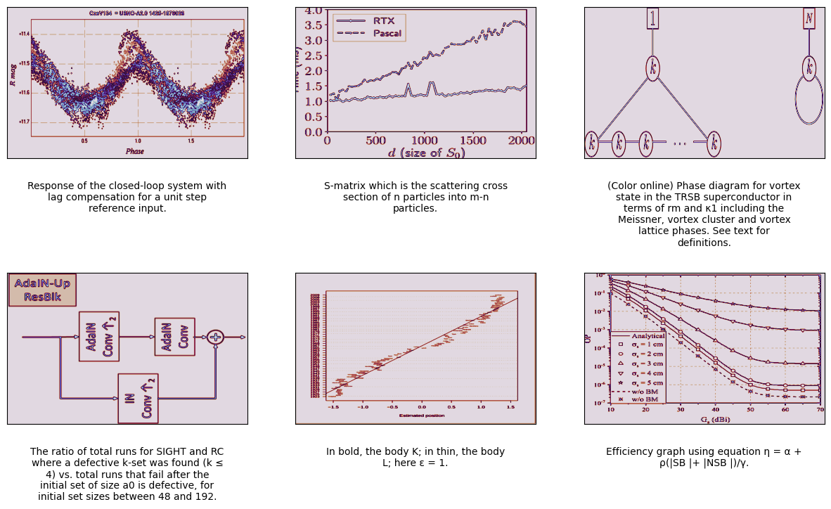
Data exploration

Slide 3
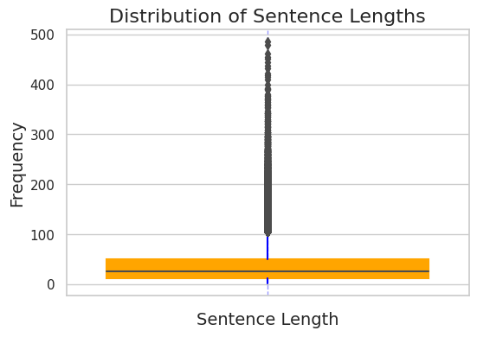
SENTENCE LENGTH ANALYSIS
The boxplot reveals that 1.5 times the interquartile range (IQR) of sentence lengths is below 100, indicating some extreme values in a section of captions. Longer input sequences pose challenges for natural language processing models, leading to increased errors in output. Therefore, only captions with lengths below 100 were included in the analysis to mitigate these challenges.

Slide 4
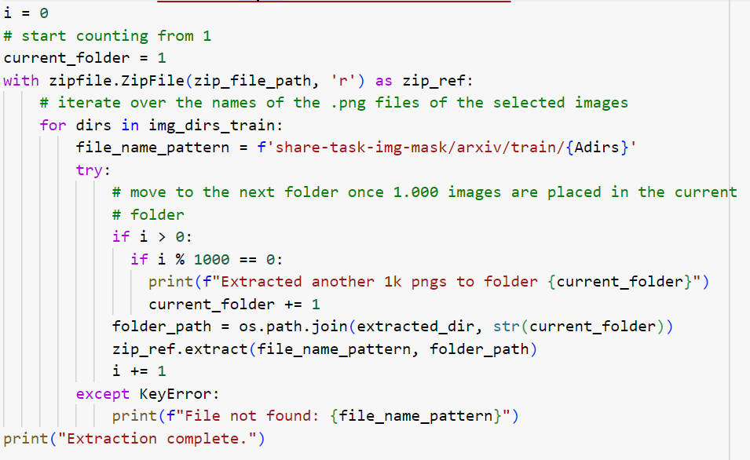
Data storing
The following step is to extract the Portable Network Graphics representations of the images from the compressed ZIP file and store them in a folder. A system of subfolders was used in order to alleviate the burden on the CUDA memory during the training process.

Slide 5
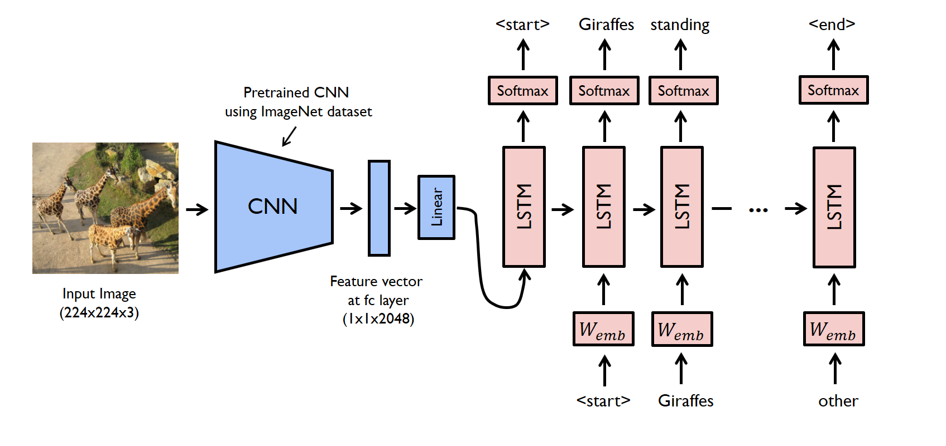
MODEL architecture
For scientific figure captioning on the SciCap dataset, a baseline CNN + LSTM model was employed. This architecture utilizes convolutional networks to extract image features, which are subsequently utilized by the LSTM decoder for word generation.

Slide 6
MODEL
Encoder
ResNet / GoogleNet
Decoder
Embedding
ReLu
Dropout
Dropout
LSTM
Linear layer

Slide 7
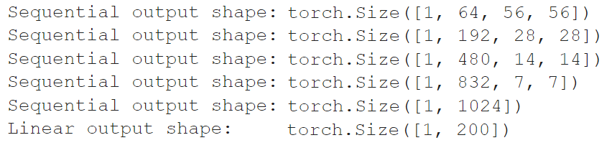
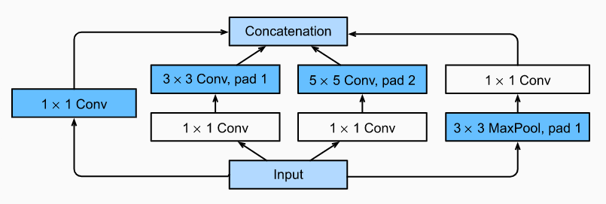
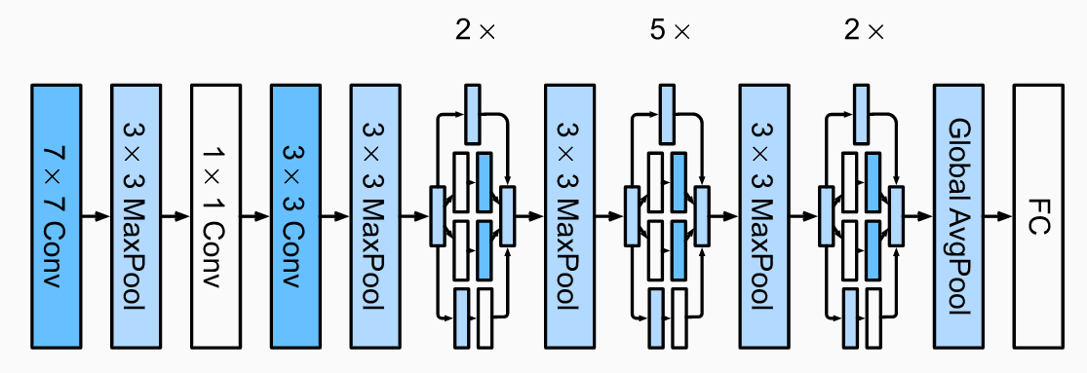
googlenet
GoogNet uses a stack of a total of 9 inception blocks, arranged into three groups with max-pooling in between, and global average pooling in its head to generate its estimates.

Slide 8
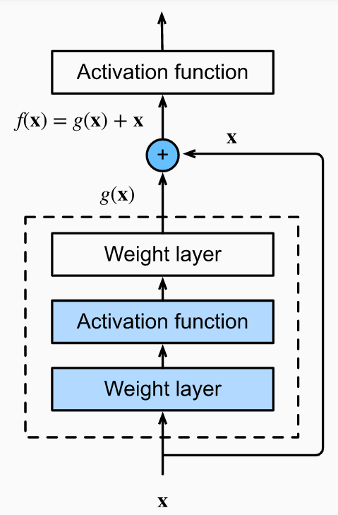
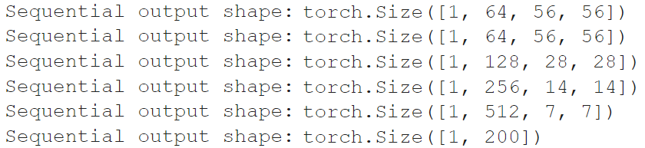
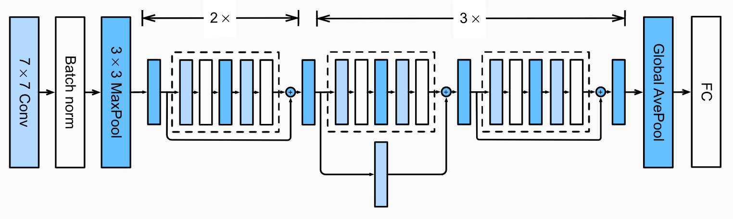
resnet
The core idea behind the ResNet architecture is using residual, or skip, connections, achieving lower error rates without introducing a lot of additional parameters to be optimized, as well as addressing the vanishing gradient problem.

Slide 9
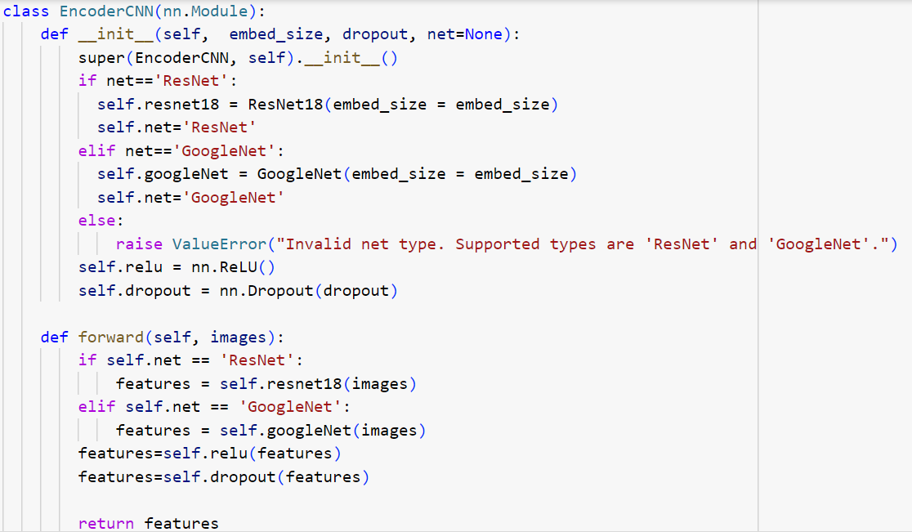
ENCODER

Slide 10
Natural language processing
Text normalization
• Converting to lowercase
• Removing extra characters
• Replacing numbers and figure indices
• Adding special tokens
Tokenization
• Splitting the text into meaningful tokens
• SpaCy English language tokenizer
Encodings
• Creating the vocabulary
• Mapping strings to numeric encodings

Slide 11
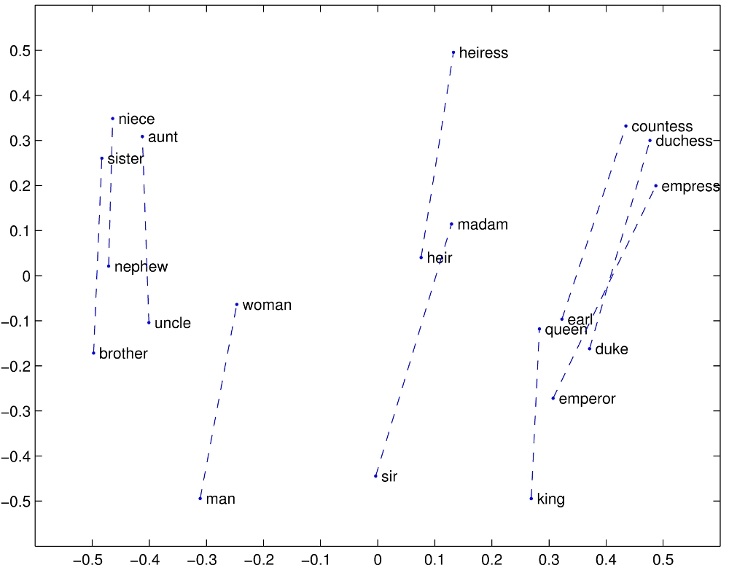
Embedding layer
• Embeddings are created for each word to introduce semantic information for the text data into the deep neural network.
• GloVe model creates distributed word representations by mapping words into space, with their semantic similarity represented. The frequency of the co-occurences of words is measured to create the embedding vectors.

Slide 12
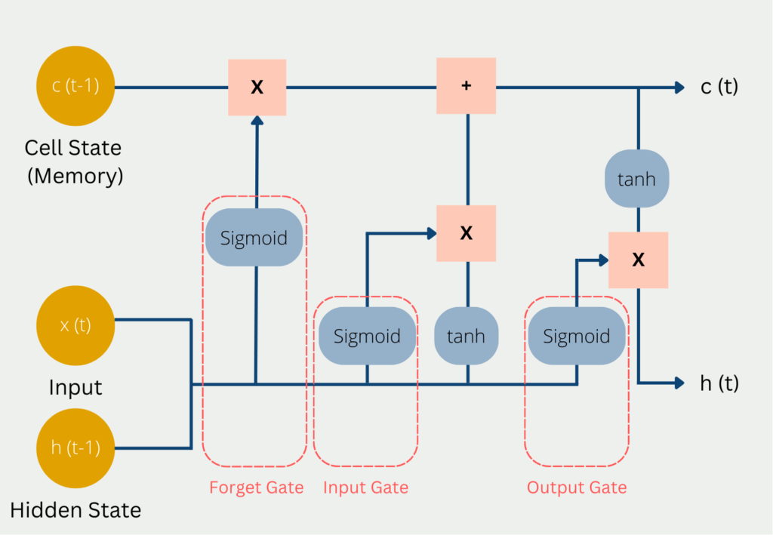
Long Short-term memory
• The natural language processing task is aimed at modelling text data while preserving its sequential nature.
• The ability of LSTMs to selectively remember or forget information is crucial for their success in capturing long-term dependencies. This is achieved through the gating mechanisms, which are trainable parameters that dynamically adjust the flow of information within the network.
• The start of sentence (SOS) and end of sentence (EOS) tokens added above are used by the LSTM to distinguish the beginnings and the ending of separate captions, and uses them as inputs for the network that it should train to recognize accordingly.

Slide 13
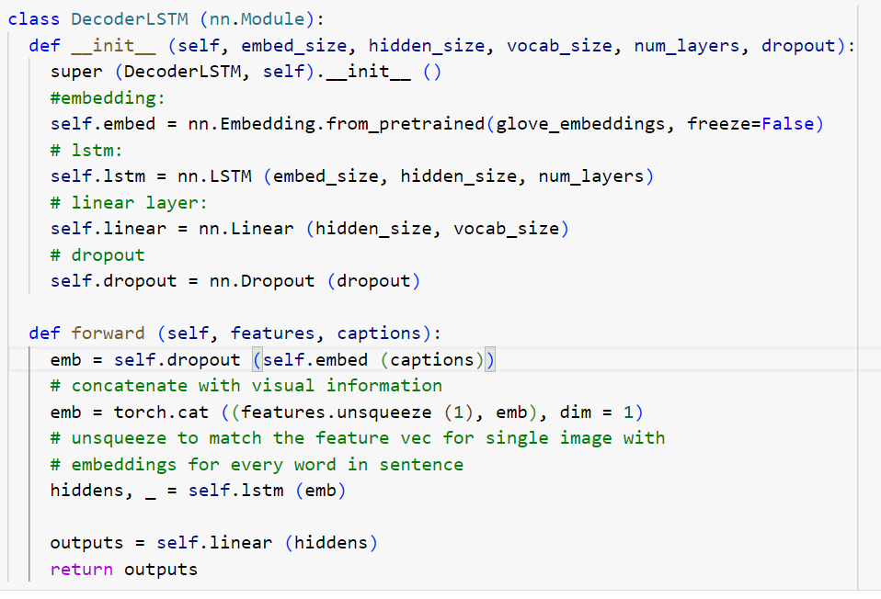
decoder

Slide 14
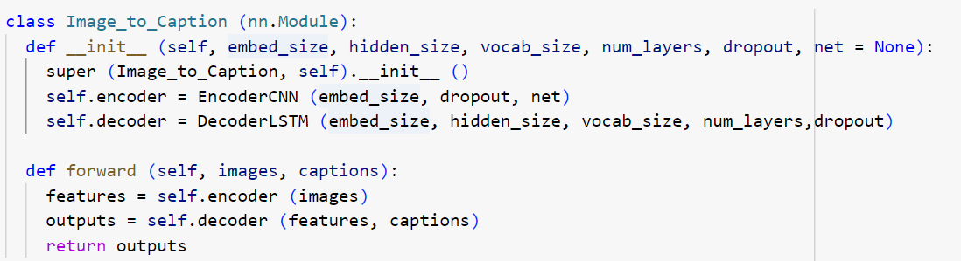
IMAGE TO CAPTION
The encoder produces a feature vector representing input data, which is fed into the decoder for natural language processing. The feature vector, holding visual information, is concatenated with word embeddings from input captions, forming the decoder input.

Slide 15
Model dimensions
LAYER | INPUT SHAPE | OUTPUT SHAPE | PARAMETERS #
- EncoderCNN | [1,1,224,224] | [1,101,16537] | --
GoogLeNet / ResNet | [1,1,224,224] | [1,200] | 6’172’280 / 11’275’848
ReLu | [1,200] | [1,200] | --
Dropout | [1,200] | [1,200] | --
- DecoderLSTM | [1,200] | [1,101,16537] | --
Embedding | [1,100] | [1,100,200] | 3’307’400
Dropout | [1,100,200] | [1,100,200] | --
LSTM | [1,101,200] | [1,101,256] | 995’328
Linear | [1,101,256] | [1,101,16537] | 4’240’009
Total parameters: ResNet-18 Encoder: 14’725’017; GoogLeNet Encoder: 19’828’585

Slide 16
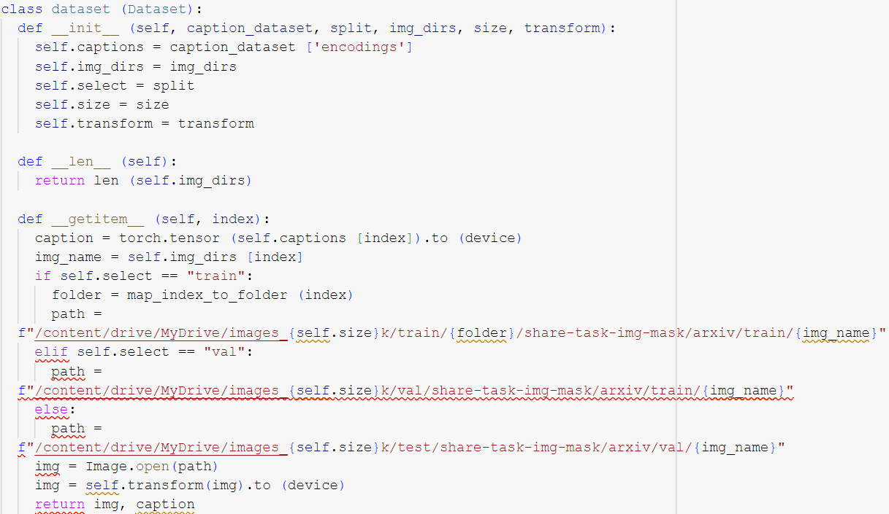
Creating the dataset class
• Dataset class is created to store the images and the corresponding captions.
• Transformation is applied to the images:
‣ Resizing as conventional for the convolutional networks.
‣ Converting to grayscale for model complexity reduction, noise elimination and better generalization
‣ Converting to PyTorch tensors for further neural network implementation.

Slide 17
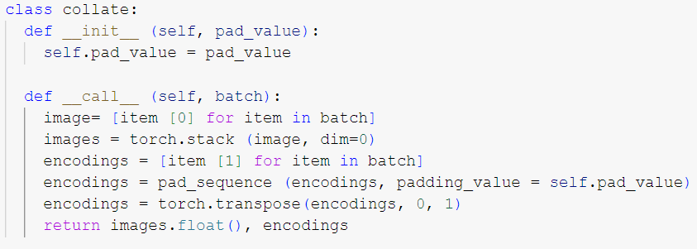
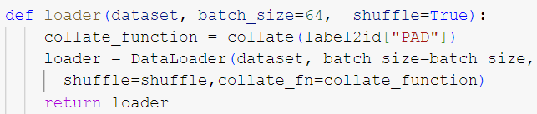
Data preparation for training
Collate
Introducing padding for uniform length batches
Selecting images and captions using image identifiers
Data Loader
Creating an iterable that guarantees enable easy access to the samples.

Slide 18
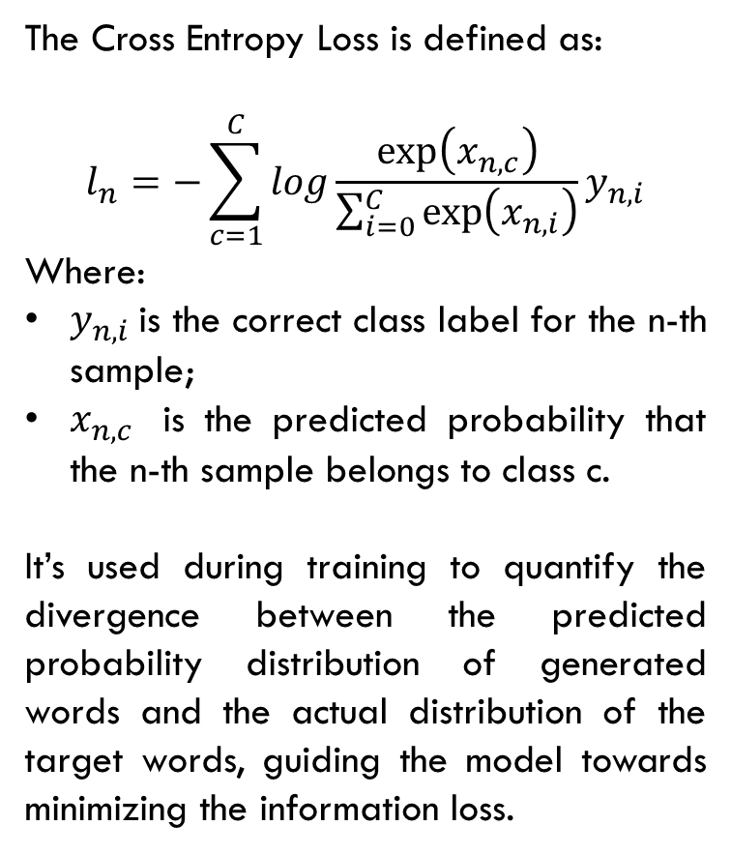
Crossentropy loss
The Cross Entropy Loss is defined as:
$$l_{n}=−\sum_{c=1}^{C}{log\frac{\exp\left(x_{n,c}\right)}{\sum_{i=0}^{C}{\exp\left(x_{n,i}\right)}}y_{n,i}}$$
Where:
$y_{n,i}$is the correct class label for the n-th sample;
$x_{n,c}$ is the predicted probability that the n-th sample belongs to class c.
It’s used during training to quantify the divergence between the predicted probability distribution of generated words and the actual distribution of the target words, guiding the model towards minimizing the information loss.
Predicted word
1 | 2 | … | 16537
0.0000344 | 0.0000562 | …. | 0.0000012
True prediction
1 | 2 | … | 16537
0 | 1 | …. | 0

Slide 19
Model generalization
• 10% of the dataset was used for the validation step. GoogLeNet and ResNet-18 models were compared, and the dropout rates of 0.1 and 0.5 for each of them were compared with the aim of fine-tuning the model.
• Reduced dropout rate of 0.1 leads to better performance. This improvement can be attributed to the fact that a lower dropout rate enables the model, particularly in the initial stages when it possesses limited knowledge of the training data, to preserve more information. This, in turn, facilitates a more efficient learning process.
• The comparative analysis reveals that, with the selected dropout rate of 0.1, ResNet outperforms GoogLeNet. The efficiency of ResNet at this dropout rate suggests a more favorable balance between regularization and feature utilization for the specific task at hand.

Slide 20
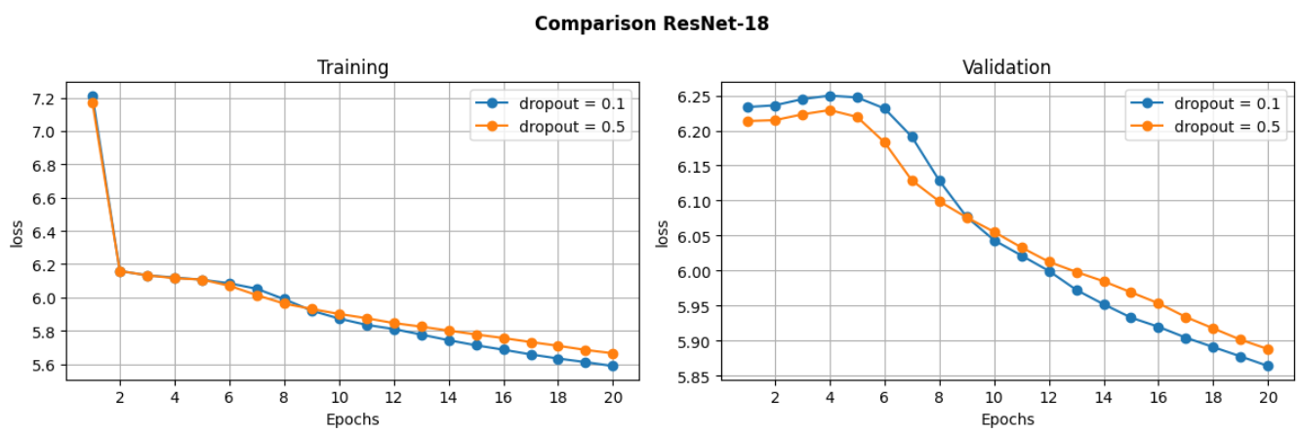
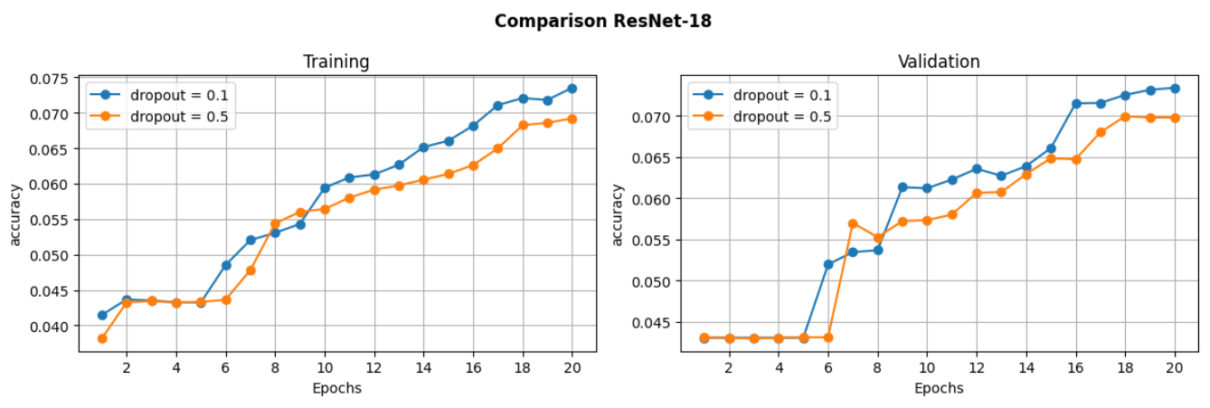

Slide 21
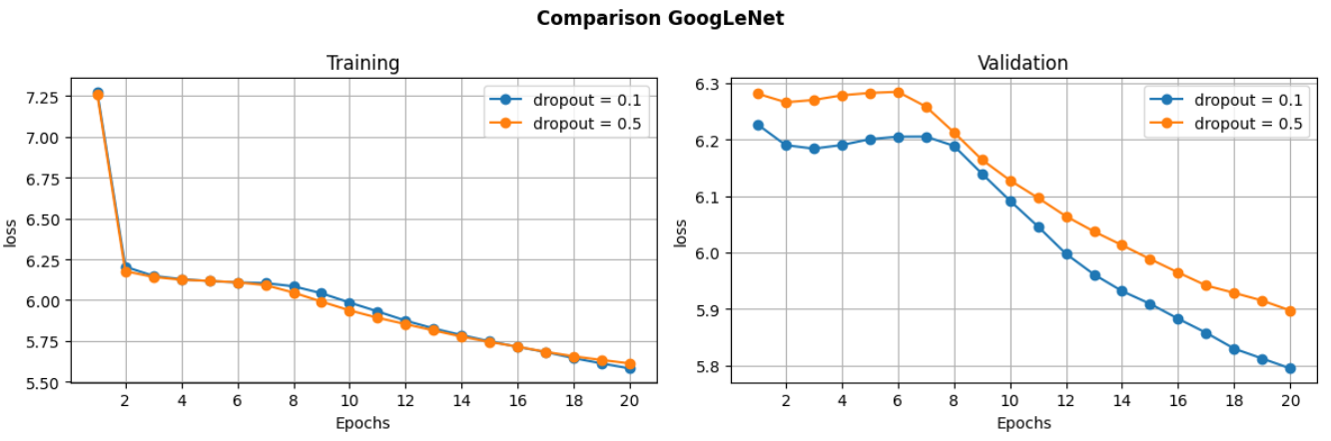
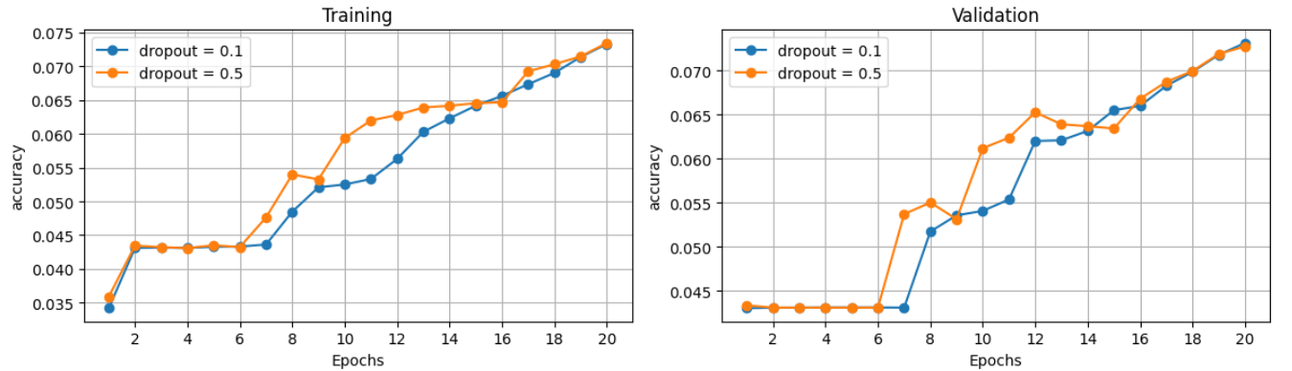

Slide 22
Model generalization
• 10% of the dataset was used for the validation step. GoogLeNet and ResNet-18 models were compared, and the dropout rates of 0.1 and 0.5 for each of them were compared with the aim of fine-tuning the model.
• Reduced dropout rate of 0.1 leads to better performance. This improvement can be attributed to the fact that a lower dropout rate enables the model, particularly in the initial stages when it possesses limited knowledge of the training data, to preserve more information. This, in turn, facilitates a more efficient learning process.
• The comparative analysis reveals that, with the selected dropout rate of 0.1, ResNet outperforms GoogLeNet. The efficiency of ResNet at this dropout rate suggests a more favorable balance between regularization and feature utilization for the specific task at hand.

Slide 23
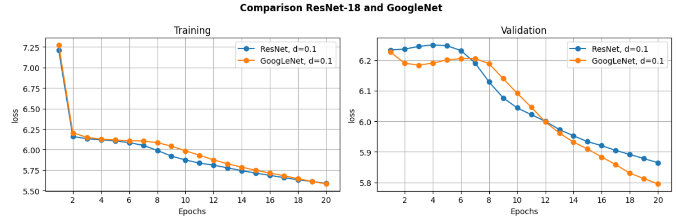
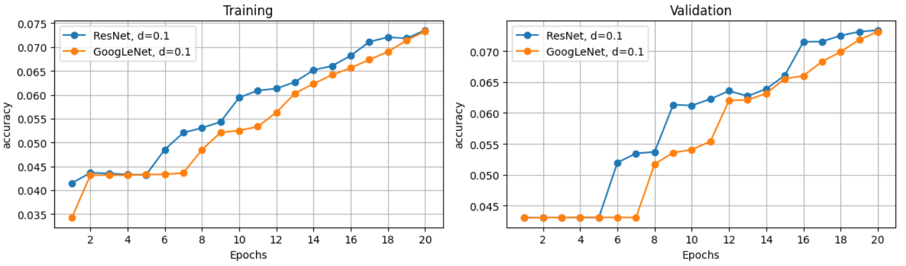

Slide 24
Model generalization
• 10% of the dataset was used for the validation step. GoogLeNet and ResNet-18 models were compared, and the dropout rates of 0.1 and 0.5 for each of them were compared with the aim of fine-tuning the model.
• Reduced dropout rate of 0.1 leads to better performance. This improvement can be attributed to the fact that a lower dropout rate enables the model, particularly in the initial stages when it possesses limited knowledge of the training data, to preserve more information. This, in turn, facilitates a more efficient learning process.
• The comparative analysis reveals that, with the selected dropout rate of 0.1, ResNet outperforms GoogLeNet. The efficiency of ResNet at this dropout rate suggests a more favorable balance between regularization and feature utilization for the specific task at hand.

Slide 25
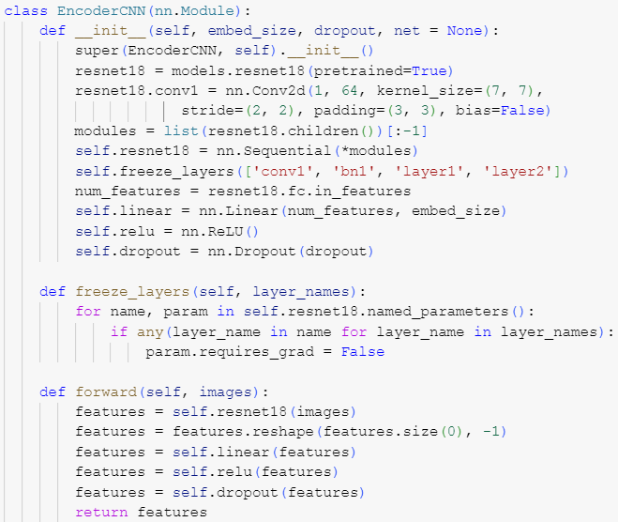
Resnet-18 pretrained
• Transfer learning approach: the weights pretrained on the ImageNet dataset were implemented for the ResNet-18.
• The fully connected layer was replaced such that to guarantee that the output size corresponds to the embedding dimensions used in the decoder, and the single input channel was accounted for.
• The initial the layers were frozen to facilitate the training process. This approach allows to take advantage of the weights pretrained on the large-scale dataset, while preserving flexibility in the later layers, guaranteeing that the optimization process fine-tunes the final output for the specific task.

Slide 26
Model dimensions
LAYER | INPUT SHAPE | OUTPUT SHAPE | PARAMETERS #
- EncoderCNN | [1,1,224,224] | [1,101,16537] | --
Sequential | [1,1,224,224] | [1,512,1,1] | 11’170’240
Linear | [1, 512] | [1,200] | 102’600
ReLu | [1,200] | [1,200] | --
Dropout | [1,200] | [1,200] | --
- DecoderLSTM | [1,200] | [1,101,16537] | --
Embedding | [1,100] | [1,100,200] | 3’307’400
Dropout | [1,100,200] | [1,100,200] | --
LSTM | [1,101,200] | [1,101,256] | 995’328
Linear | [1,101,256] | [1,101,16537] | 4’240’009
Total parameters: 19’828’577

Slide 27
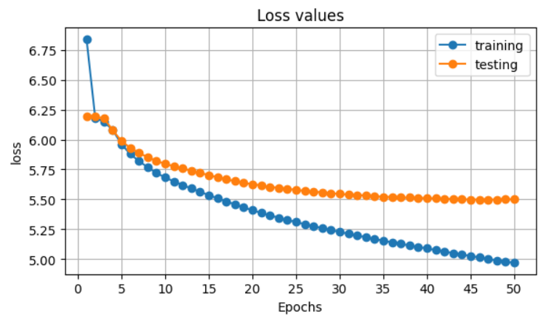
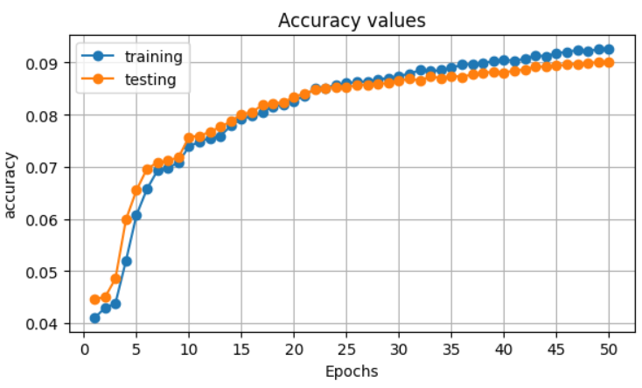
Final evaluation results
The final accuracy, achieved with the utilization of pretraining, surpasses the accuracy obtained without pretraining by approximately 2%. While this improvement may seem modest, it is noteworthy considering the scale of the values involved and the inherent complexity of the problem at hand.
ACCURACY | PRECISION | RECALL | F1 | BLEU
0.087995 | 0.048109 | 0.087995 | 0.057118 | 0.00001

Slide 28
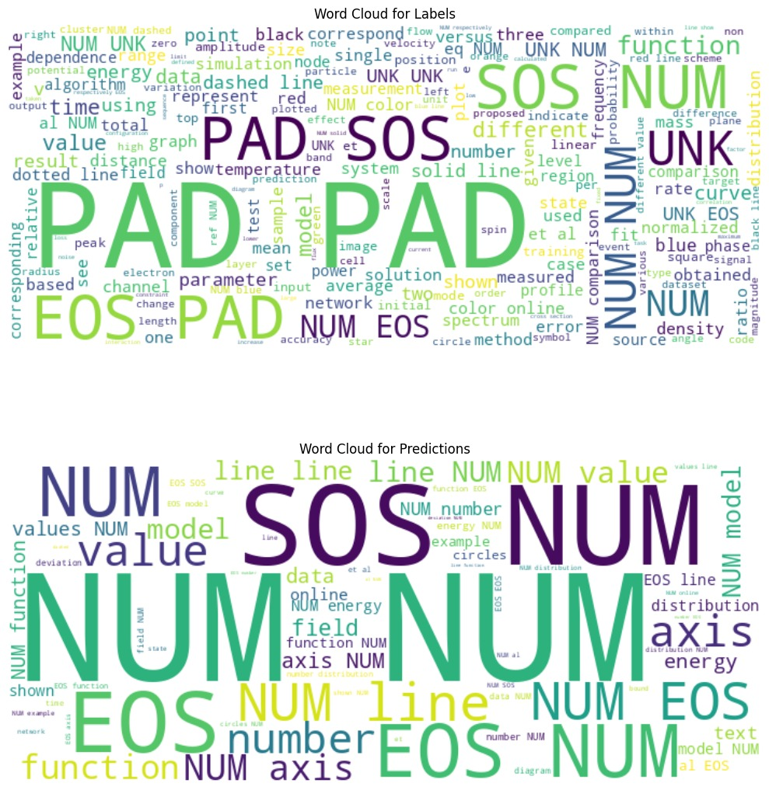
Wordcloud
True Captions
Predicted captions

Slide 29
Conclusions
• Due to the difficulty of the presented problem, as well as the complicated nature of the data, it was not possible to achieve good performance and high values for the metrics for the evaluation of the model.
• Nevertheless, there exist possibilities for improvements to be implemented to the setting and the architecture in the future:
‣ Increasing the number of images used for the analysis and the number of epochs.
‣ Introducing a preliminary step where the ResNet-18 pretrained encoder would be additionally fine-tuned on the FigCap dataset (Zhang et al. (2023)), which comprises of synthetically generated scientific figures.
‣ Implementing advanced text normalization techniques using machine learning techniques at the preliminary steps of the analysis.
‣ Adding an attention mechanism to the decoder architecture, or using a vision transformer architecture, utilising the concept of patch embeddings.

Slide 30
Thank you for your attention
Corrà Sara and Shaboian Goar

Slide 31
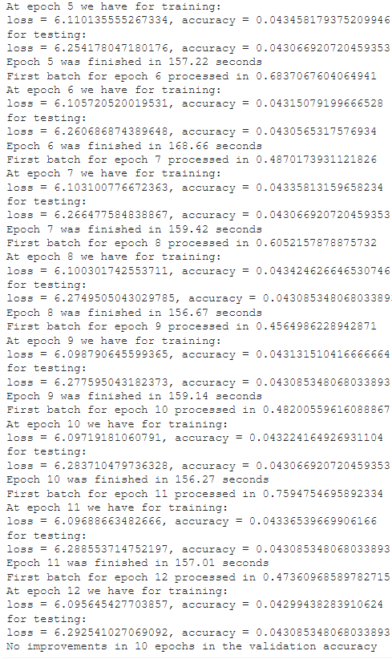
4 layers, 0.1 dropout

Slide 32
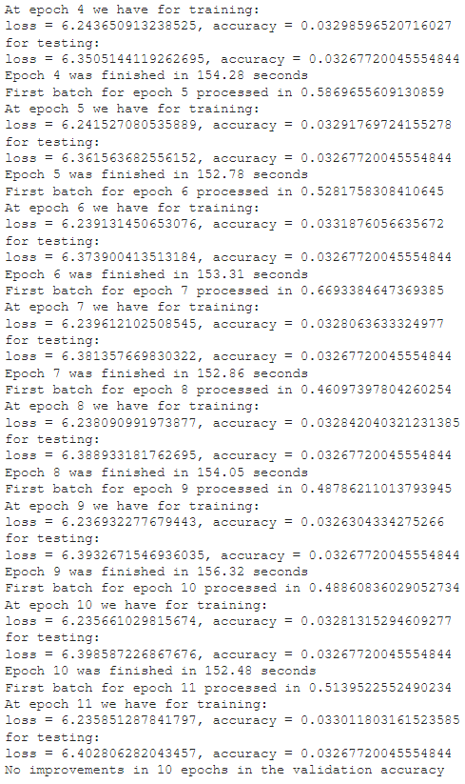
4 layers, 0.5 dropout

